Slide 1

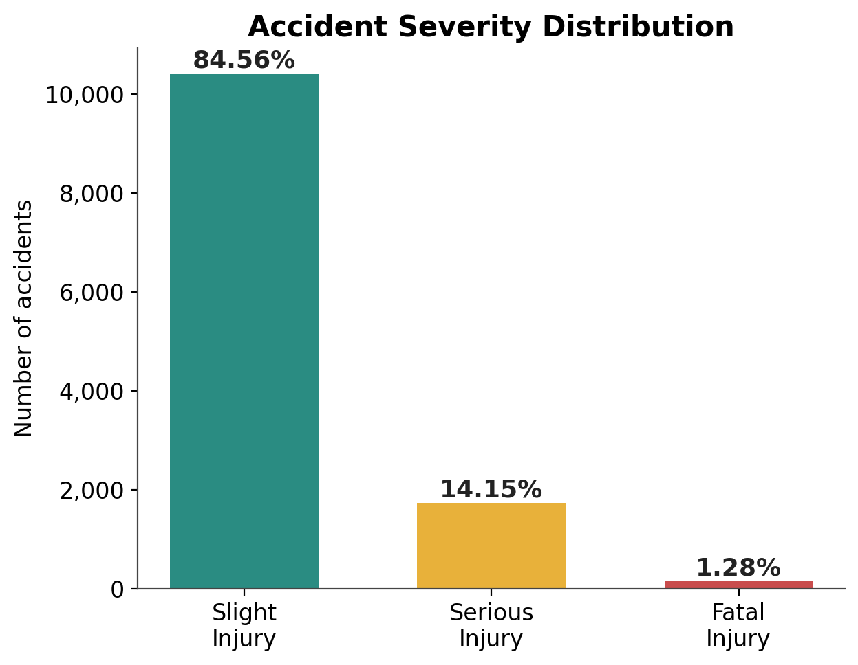
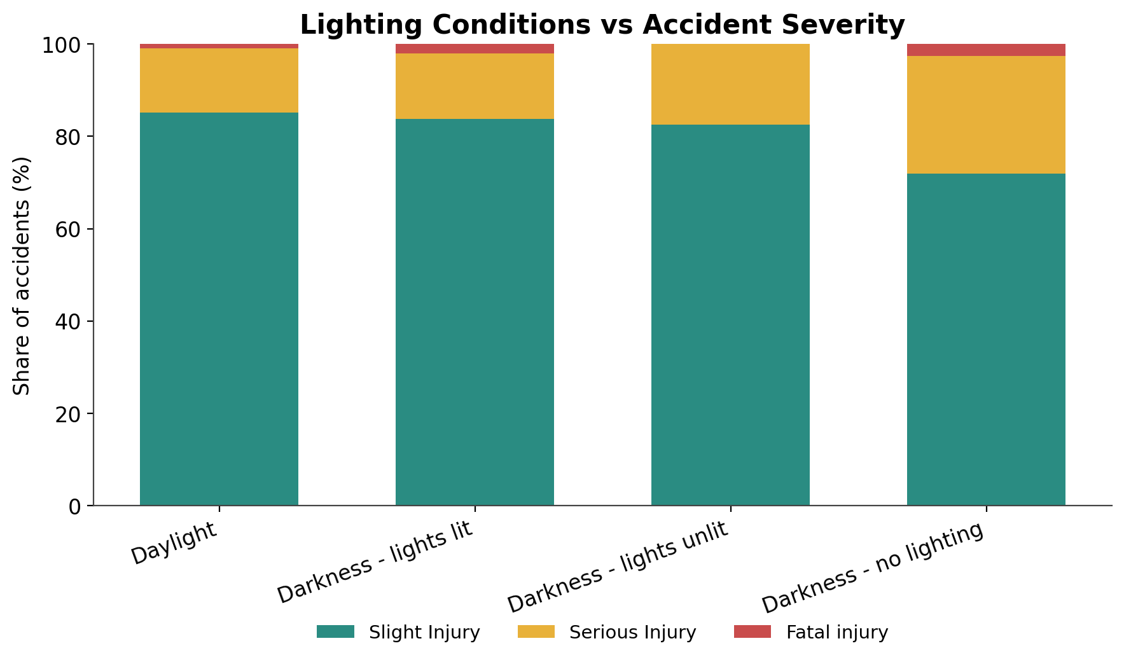
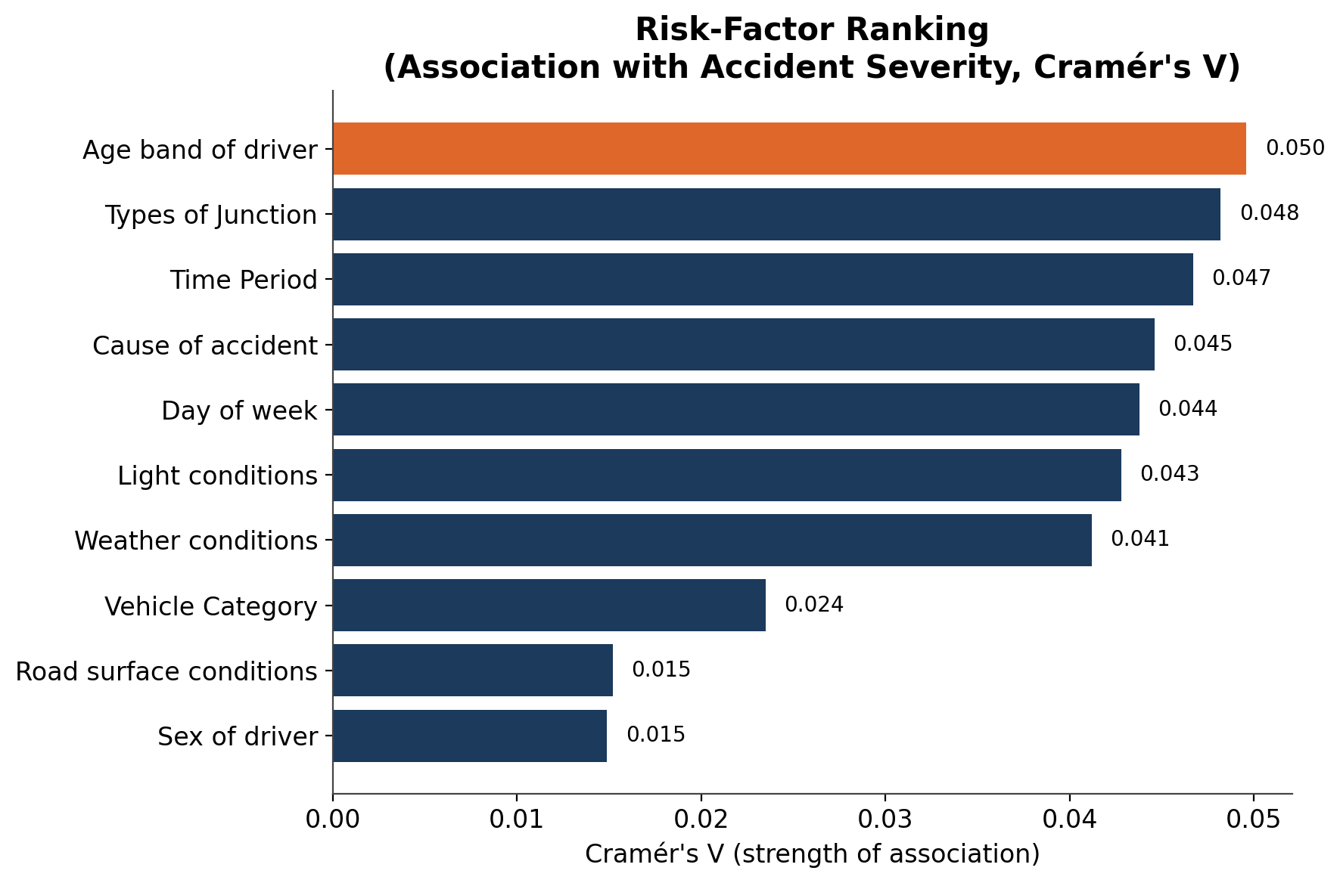
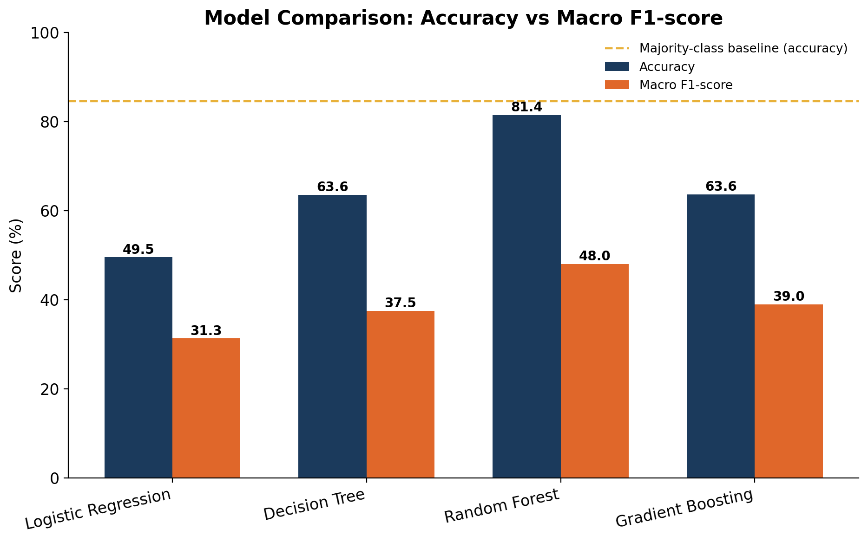
Exploratory Analysis of Road Accident Data to Identify Key Risk Factors
Fundamentals of Data Science • DSA0405
Kishore Kumar P | Reg. No. 192424108 | B.Tech AI & Data Science
SIMATS, Chennai
Introduction
Dataset — Road Accident Severity Records
Problem
Approach
Why FODS?
▪ 12,316 police-recorded accidents • 32 original features • 2017–2020
▪ Driver, vehicle, road/junction, weather, lighting and severity variables
▪ Documented source: Addis Ababa Sub-city Police Department, Ethiopia
Severity depends on interacting human, road, vehicle and environmental factors.
EDA + χ²/Cramér's V + classification identify measurable risk patterns.
Turns 12,316 records into evidence for targeted road-safety actions.
Provenance: distributed on Kaggle under “Road Accident Severity in India,” but the documented records are Ethiopian.
Methodology — Data Science Pipeline
Results — Key Findings
01
Data Cleaning
02
Exploratory Analysis
0 duplicates; missing fields retained as “Unknown”; time/day/vehicle categories standardized.
Severity, time, weather, lighting, road, junction, vehicle and driver patterns compared.
03
Statistical Testing
04
Predictive Modeling
χ² tests + Cramér's V measure association strength; p < 0.05 treated as significant.
Four classifiers compared; macro-F1 is primary because severe outcomes are rare.
Conclusion & Next Steps
84.56% Slight, 14.15% Serious and 1.28% Fatal — a strongly imbalanced outcome.
Driver age, junction, time, lighting and weather are significant, but effect sizes remain small.
Random Forest: 81.4% accuracy and 0.480 macro-F1; rare severe cases remain difficult to detect.
Actions: improve unlit-road lighting, strengthen following-distance awareness, and validate with local Indian data.
12,316
1.28%
28.12%
81.4%
0.480
Accidents
Fatal rate
Unlit darkness
RF accuracy
RF macro-F1

